Slide 1
NextHikes IT Solutions
Telecom User Analytics Project by Harsimran Kaur

Slide 2
Introduction
Telecommunication companies generate huge amounts of customer usage data daily. This project analyzes telecom customer behavior, engagement, network experience, and satisfaction using data analytics and machine learning techniques.
Objectives:
• Understand customer usage patterns • Measure engagement levels • Analyze customer experience • Predict satisfaction • Support acquisition decision making

Slide 3
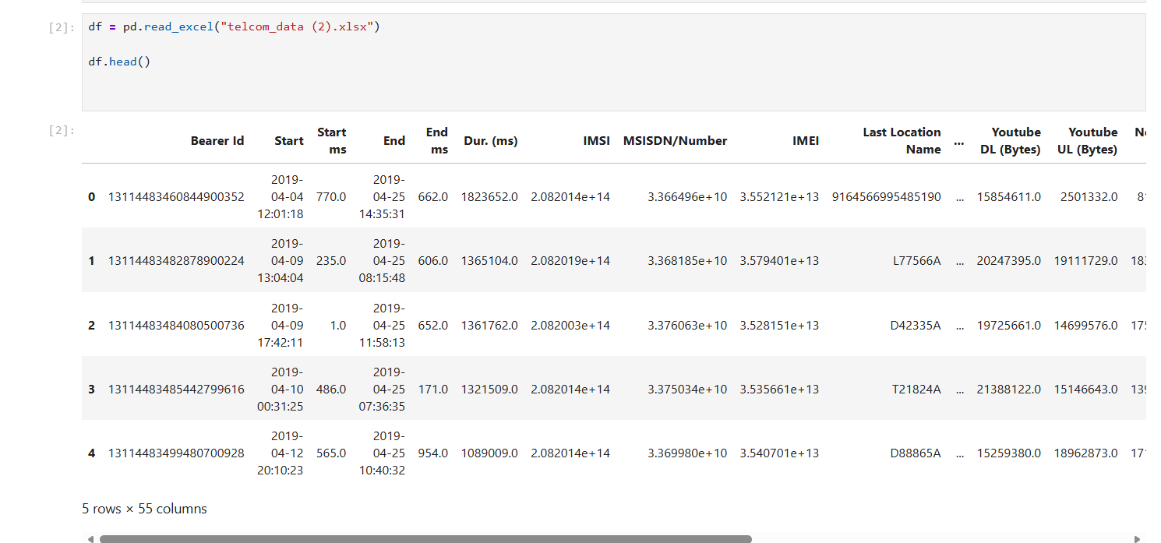
Problem Statement & Objectives
Telecommunication companies generate massive customer data daily.
Challenges:
• Understanding usage behavior
• Measuring customer satisfaction
• Detecting low-value users
• Improving network experience
• Making data-driven decisions
Objectives:
• Analyze customer behavior
• Measure engagement levels
• Segment customers
• Predict satisfaction
• Support business growth

Slide 4
Dataset Overview
The telecom dataset contains customer usage and service information used for analysis.
Total Records: 88,245
Total Columns: 55
Large-scale real telecom dataset
Includes usage, duration, device, and location details
Used for behaviour analysis and segmentation

Slide 5
Data Preprocessing
Before analysis, the dataset was cleaned and prepared for accurate results.
Missing values were checked and handled
Unnecessary columns were removed
Column names were standardized
Data types were corrected
Duplicate records were verified
Important features were selected for analysis

Slide 6
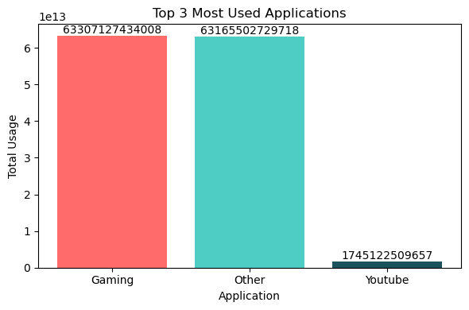
Exploratory Data Analysis
EDA was performed to understand telecom customer usage behavior.
• Most used applications
were identified
• Gaming and Other apps
show highest usage
• YouTube usage is comparatively
lower
• Customer digital preferences were
analyzed
• Insights help in targeted service planning

Slide 7
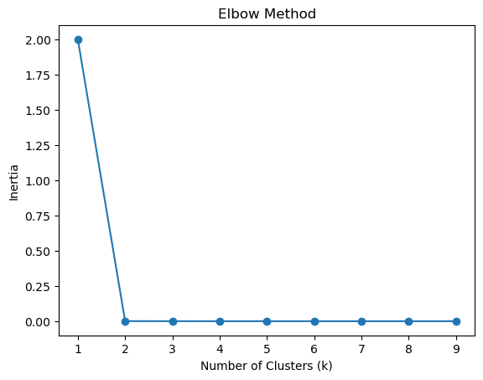
User Segmentation using K-Means
K-Means clustering was applied to segment telecom users based on behaviour.
• Elbow Method used to find optimal cluster value
• Best clustering point selected after curve bend
• Users divided into meaningful groups
• Helped identify different customer types
• Useful for personalized business strategies

Slide 8
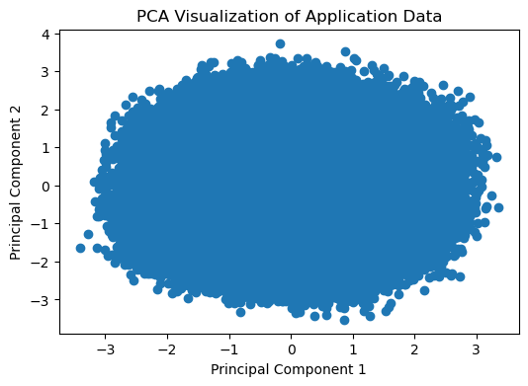
Cluster Visualization using PCA
Principal Component Analysis (PCA) was used to visualize high-dimensional telecom data.
• Data reduced into 2 dimensions
• Helps understand customer grouping patterns
• Similar users appear closer together
• Useful for cluster interpretation
• Supports segmentation analysis

Slide 9
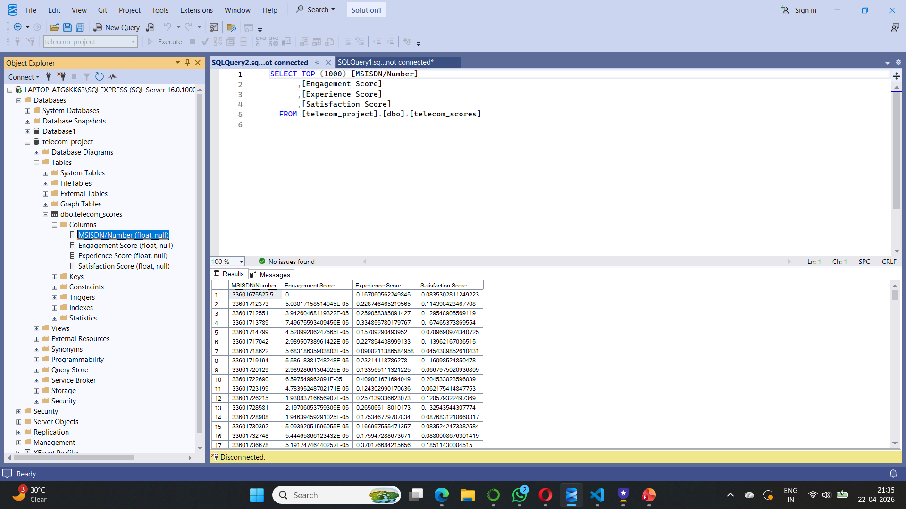
Engagement Analysis
Customer engagement was measured
using calculated engagement scores.
• High scores indicate active users
• Low scores indicate less interaction
• Helps identify valuable customers
• Supports retention strategies
• Used in customer segmentation

Slide 10
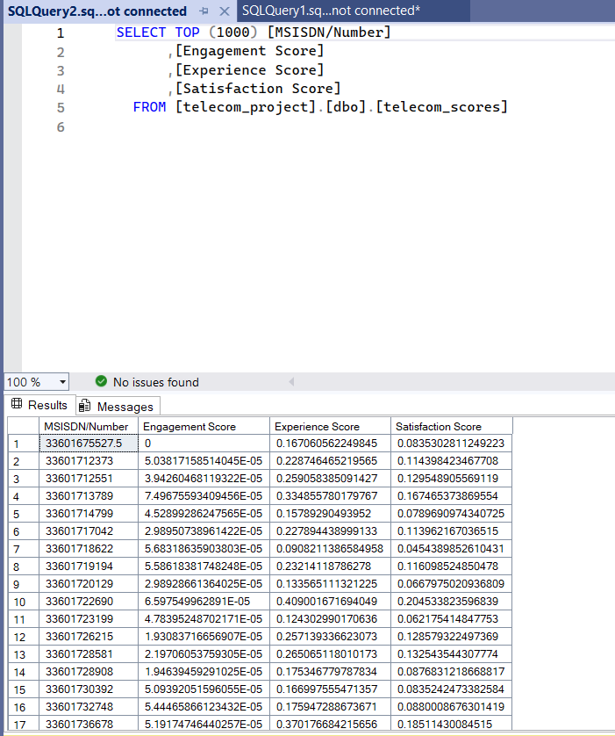
Experience Analysis
Customer experience was measured using calculated experience scores.
• High scores indicate better network/service experience
• Low scores may reflect poor service quality
• Helps identify problem areas
• Supports quality improvement strategies
• Strong impact on customer loyalty

Slide 11
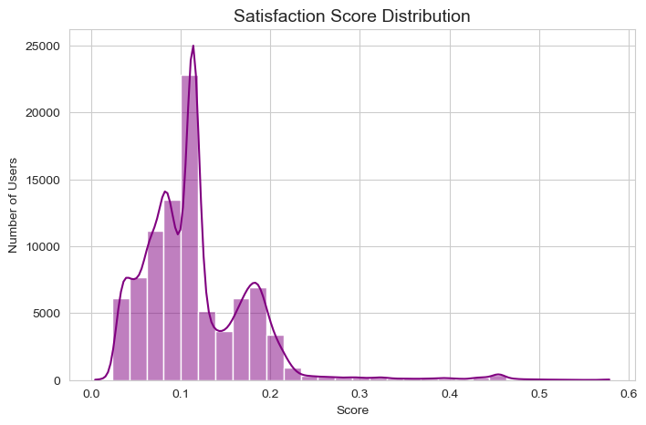
Satisfaction Analysis
Customer satisfaction was evaluated using satisfaction scores.
• Most users are concentrated in lower score range
• Peak values appear near 0.10 – 0.12
• Few users show high satisfaction
• Indicates need for service improvement
• Better experience can increase satisfaction

Slide 12
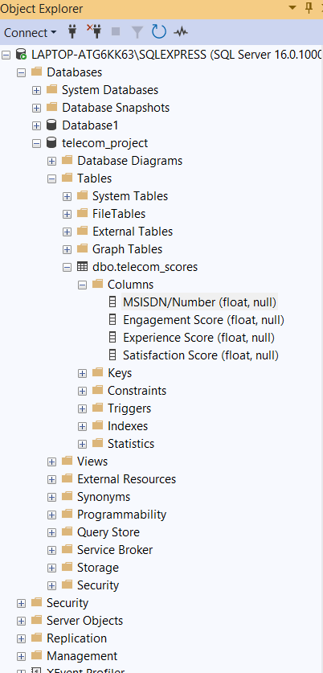
SQL Database Integration
Processed telecom data was stored in SQL Server.
• Database: telecom_project
• Table: telecom_scores
• Stores final calculated scores
• Easy querying and reporting
• Supports business decisions

Slide 13
Business Recommendations
Based on analysis, telecom companies should:
Improve service quality for low satisfaction users
Offer personalized plans to increase engagement
Reduce network issues in weak locations
Focus retention strategies for valuable users
Use analytics dashboards for regular monitoring
Improve customer support response time

Slide 14
Future Scope
This project can be enhanced further by:
Real-time customer monitoring system
AI-based churn prediction model
Personalized recommendation engine
Live dashboard integration with cloud
Advanced deep learning models
Mobile app for telecom managers

